Slide 1

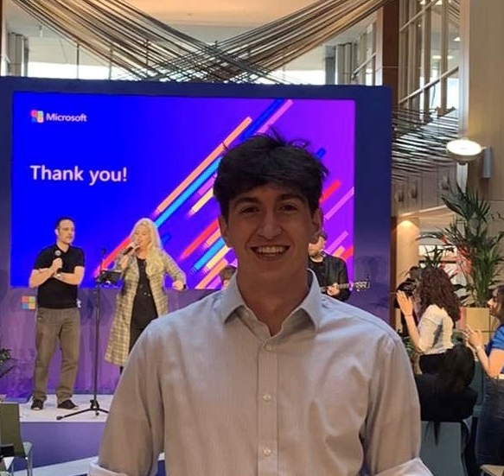


Career Festive – What roles are in Microsoft for Interns and Grads
Sat 28 May
Ethan Jones
Gianluca Sanfilippo
Rosen Georgiev
Cloud Solutions Architect
Account Delivery Executive
Security Technical Specialist

Slide 2
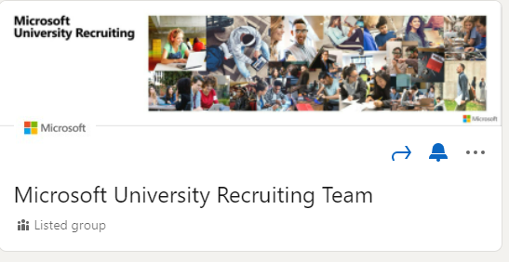
Next Steps
Update your Resume
Clearly list your graduation date, work experience, personal/academic projects, and leadership/volunteer efforts
Microsoft University Recruiting
If you’re interested in internship / full-time positions @ Microsoft – www.microsoft.com/university
Follow Microsoft University Recruiting Team on LinkedIn
Make Connections – Network!
No matter what year you are in school, now is the time to network as much as you can. By the time you are making career decisions, you want to be as well informed and experienced as possible
Prepare and practice for a technical interview

Slide 3
Next steps
Resources from today!
Microsoft-Build-Student-Developer-Drop-in-day Resources
Student Hub
https://aka.ms/learnstudent
Cloud Skills Challenge https://aka.ms/StudentDeveloperDayChallenge

